Slide 1
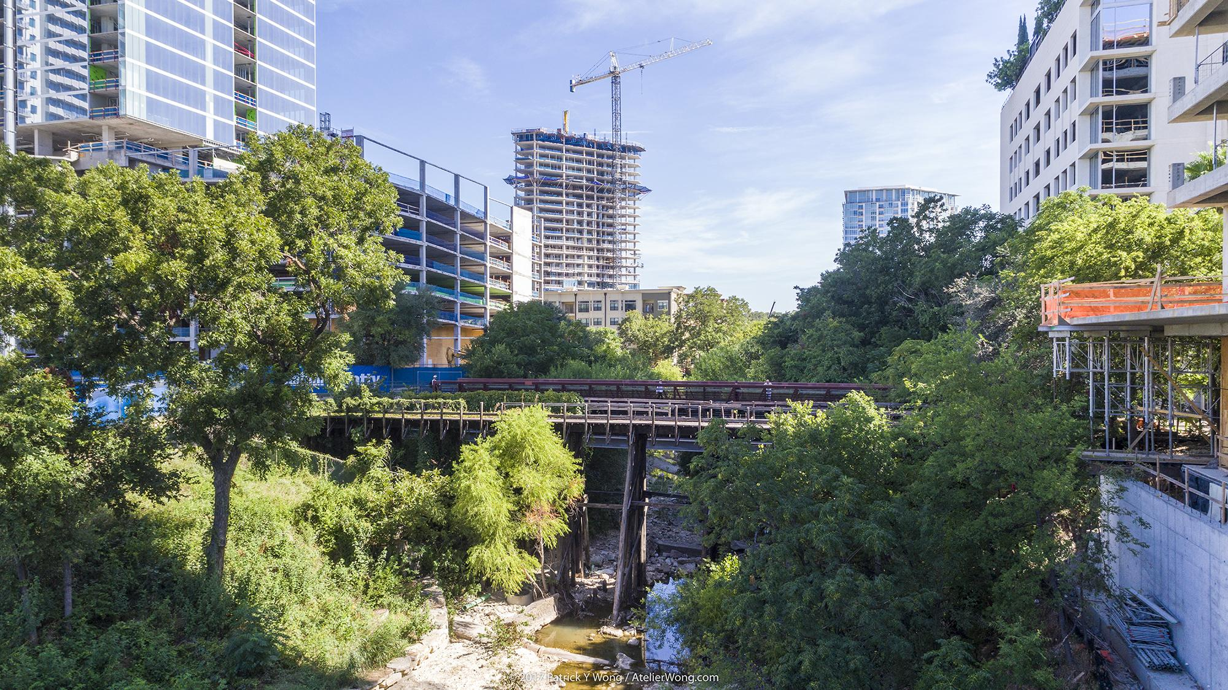

SHOAL CREEK WATERSHED ACTION PLAN
Stakeholder Meeting: August 15, 2019
Notes:
Intro slide only

Slide 2
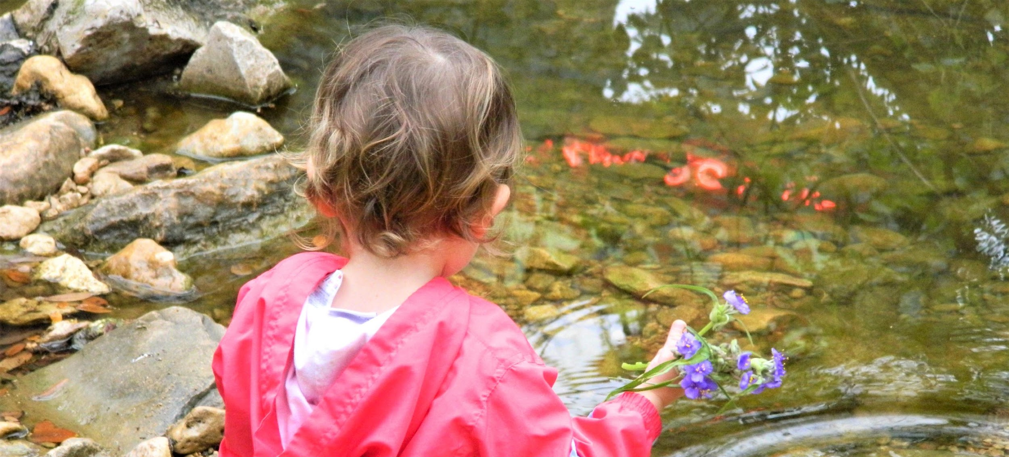
Welcome & Agenda Review
Quick Updates:
  By Laws revised and added to project website: shoalcreekconservancy.org/watershedplan
  Comments received on Watershed Characterization Report, next draft Jan. 30
  Next meeting on Jan. 30 from 9:30 to 11 a.m (location downtown TBD)
Today:
  Facilitated goal discussion
  Organizational Meeting of Working Groups

Slide 3
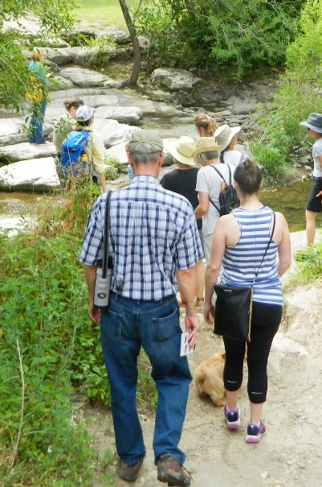
April
July 9 Recap &
Goal Statement Reminder
Shoal Creek is a model healthy and resilient urban watershed that benefits people and nature and is supported by a well-informed and engaged community.

Slide 4
Watershed Plan - Manage Pollutants
Shoal Creek plan needs to meet State contact recreation standards
  Currently does not
Shoal Creek water quality is better than state screening levels for these pollutants
  Total nitrogen – Currently higher than Bull Creek
  Total phosphorus – levels comparable to Bull Creek
  Total suspended solids – levels comparable to Bull Creek

Slide 5
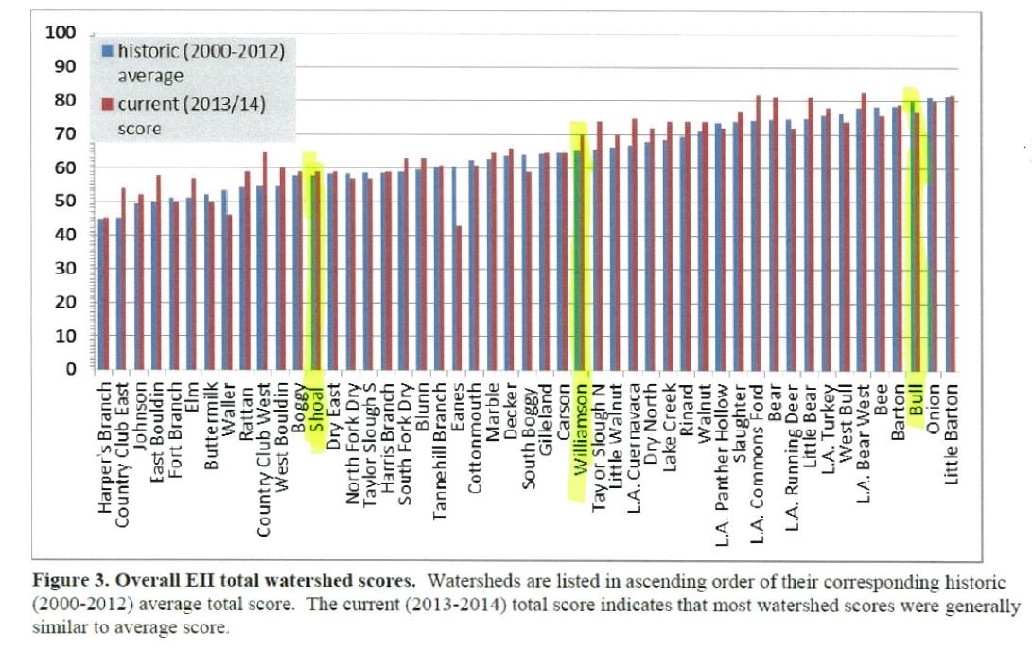
Watershed Comparison

Slide 6
Watershed Comparisons
Watershed | Type | Imp Cover (%) | EII Score out of 100 | Water Quality | Developed Area Treated
Shoal | Urban | 54 | 58 | Fair | Minimal
Williamson | Suburban | 34 | 66 | Good | Moderate
Bull | Suburban | 21 | 80 | Very Good | Most
EII - Environmental Integrity Index (water quality, sediment, contact recreation, non-contact recreation, physical integrity, aquatic life, benthics, diatoms)

Slide 7
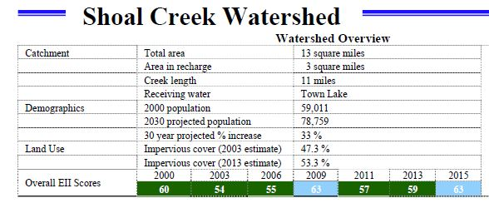
Shoal Creek Water Quality – Environmental Integrity Index

Slide 8
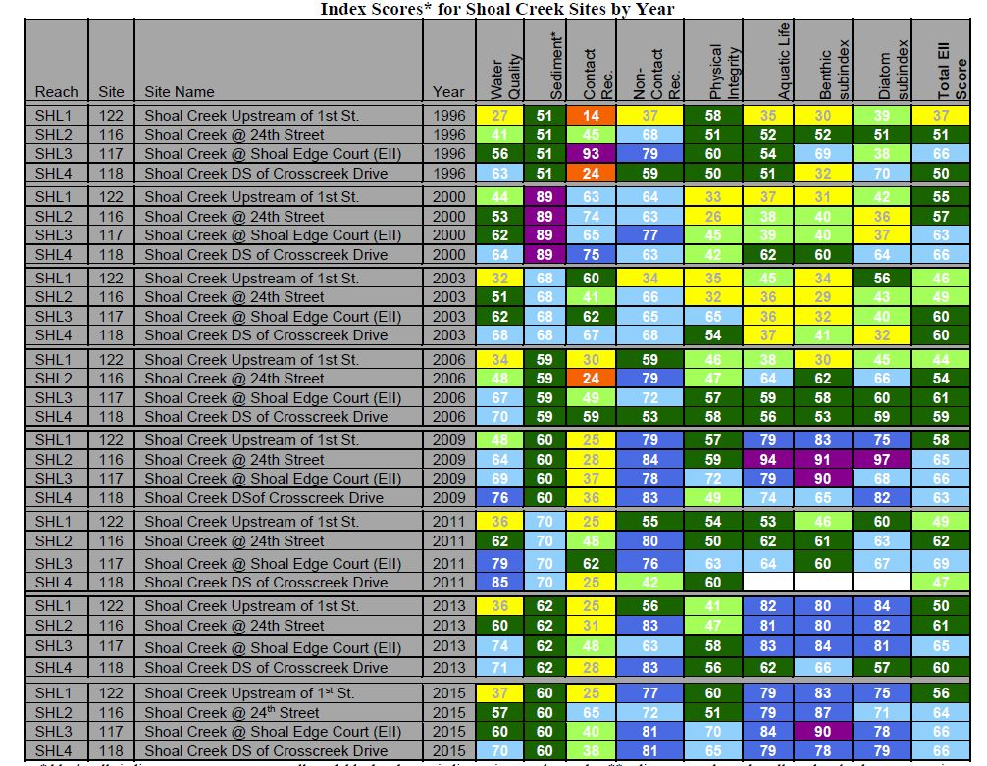
Shoal Creek
EII
2015 EII scores
added to the
summary

Slide 9
Water Goals? Summary from July 9
Achieve contact recreation standards per TCEQ
Promote baseflow enhancement
Reduce herbicides, nutrients, pesticides
Enhance riparian health
Support City flood mitigation efforts
Consistently achieve “Good” water quality within 20 years per EII
Adaptive management

Slide 10
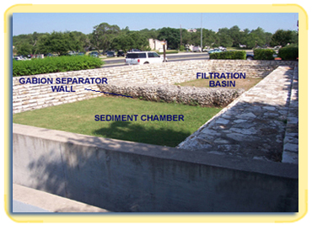
Potential Management Measures
Education and outreach, combined COA and SCC effort
Bacteria management, Scoop the Poop, signage, etc.
Investigate retrofit of existing regional detention basins
  Baseflow enhancement?
Coordinate with City on water quality projects
Land Development Code Revisions
Expand creekside grow zone program
Operations and maintenance
  Street sweeping, etc.

Slide 11
Implementation Concepts
New development will comply with the City’s WQ Ordinance
City of Austin capital projects (retrofits and creek erosion mgmt)
City of Austin drainage fee reduction incentives
Modified Land Development Code – redevelopment to manage runoff to “greenfield” condition?
Flood planning process
Private public partnerships
Foundations/grants

Slide 12
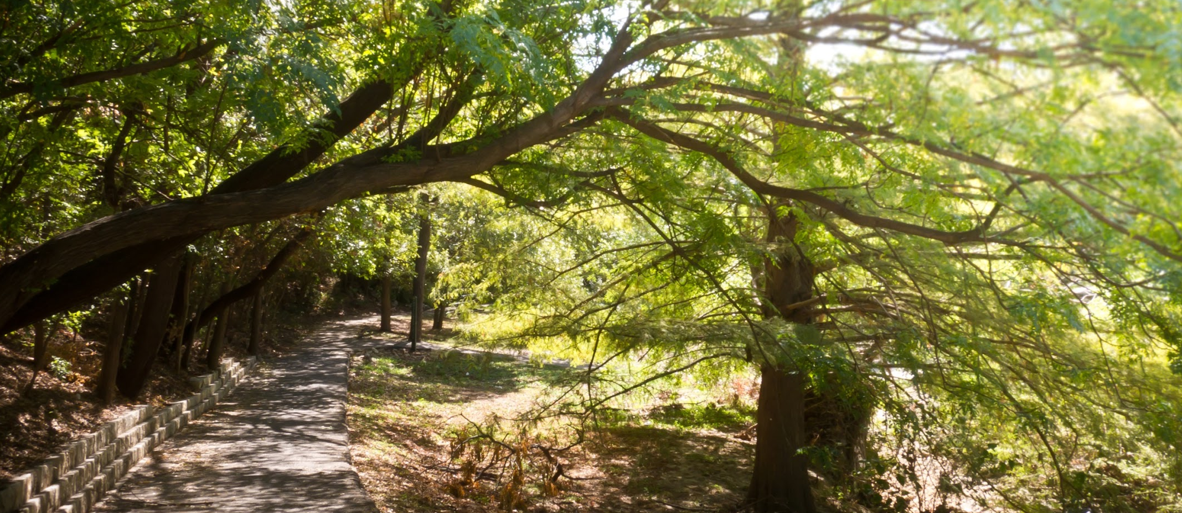
Thank you
Joanna Wolaver, Shoal Creek Conservancy joanna@shoalcreekconservancy.org www.shoalcreekconservancy.org/watershedplan
Wrap-Up & Public Comments

Slide 13



Partners
And Shoal Creek Stakeholders
This cooperative project is funded in part by the Texas Commission on Environmental Quality (TCEQ) through a United States Environmental Protection Agency (EPA) grant.

