Slide 1
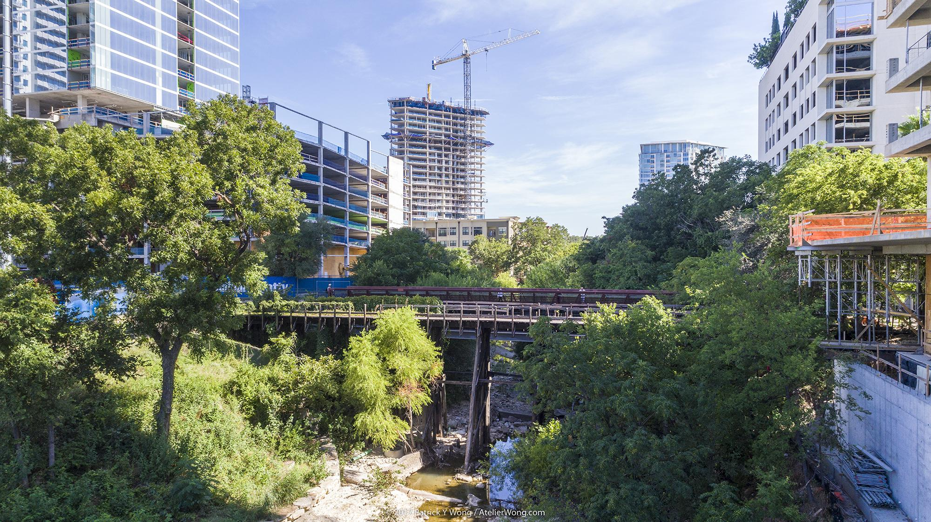

SHOAL CREEK WATERSHED ACTION PLAN
Stakeholder Meeting: September 25, 2019
Notes:
Intro slide only

Slide 2
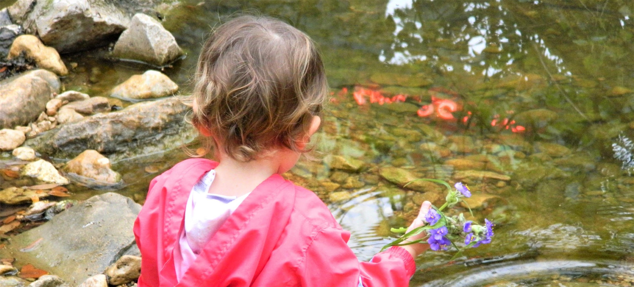
Welcome & Agenda Review
Quick Updates:
  By Laws revised and added to project website: shoalcreekconservancy.org/watershedplan
  Comments received on Watershed Characterization Report, next draft Jan. 30
  Next meeting on Jan. 30 from 9:30 to 11 a.m (location downtown TBD)
Today:
  Facilitated goal discussion
  Organizational Meeting of Working Groups

Slide 3
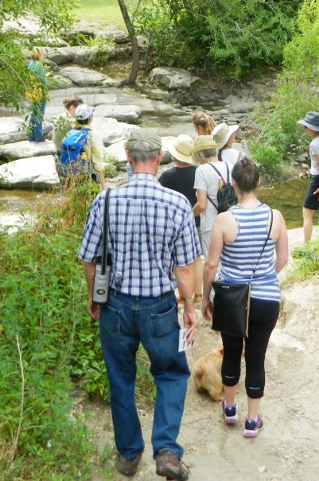
April
August 15 Recap &
Goal Statement Reminder
Shoal Creek is a model healthy and resilient urban watershed that benefits people and nature and is supported by a well-informed and engaged community.

Slide 4
Water Goals - Summary from August
Achieve contact recreation standards per TCEQ
Promote baseflow enhancement
Promote aquatic health
Enhance riparian health
Support City flood mitigation efforts
Consistently achieve “Good” water quality within 20 years per EII

Slide 5
Watershed Comparisons
Watershed | Type | Imp Cover (%) | EII Score out of 100 | Water Quality | Developed Area Treated
Shoal | Urban | 54 | 58 | Fair | Minimal
Williamson | Suburban | 34 | 66 | Good | Moderate
Bull | Suburban | 21 | 80 | Very Good | Most
EII - Environmental Integrity Index (water quality, sediment, contact recreation, non-contact recreation, physical integrity, aquatic life, benthics, diatoms)

Slide 6
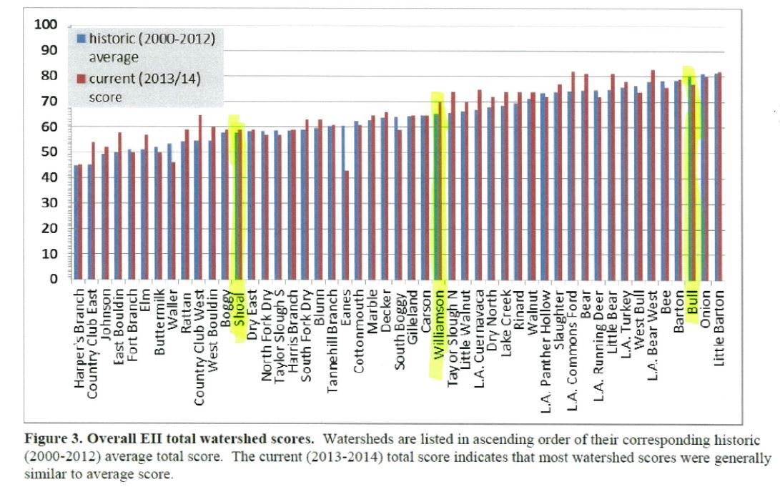
Watershed Comparison

Slide 7
Current Conditions
Standards/Criteria/Goal | Criteria/Goal | Performance
Bacteria | 126 MPN/100 mL | Not Met
Total Phosphorus | 0.69 mg/L | Met
Total Nitrogen | 1.95 mg/L | Met
Total suspended solids | 96 mg/L | Met
EII Score | Good to Very Good | Not Met

Slide 8
Measures to Meet Contact Recreation
Measure | Effectiveness | Feasibility | Cost
Scoop the Poop Program (Dog waste education in parks) | High | High | $
Install Pet Waste Bag Dispensers in Parks | High | High | $
Private Lateral Inspection Program | Moderate | Medium | $$
Wastewater Infrastructure Inspection & Repair | Moderate | Unknown | $-$$$
Residential Education Programs | Low | High | $
Sanitary Sewer Overflow Response | High | High | $-$$$

Slide 9
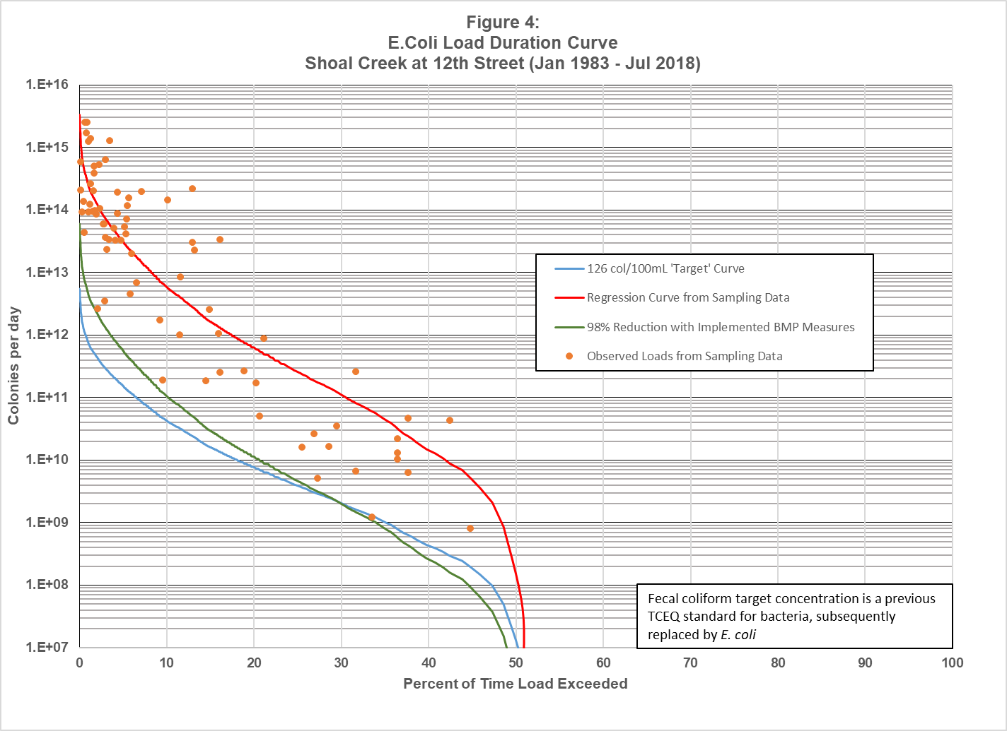
E.Coli Load Duration Curve

Slide 10
Measures to Promote Aquatic Health
 | Effectiveness
Measure | Phosphorus | Nitrogen | TSS | Bacteria | Feasibility | Cost
Grow Green Lawn Program | High | High | - | - | Low | $
Grow Zones | High | High | High | High | Moderate | $$
Bank Stabilization Projects | Moderate | Moderate | High | Low | High | $$$
Expanded Street Sweeping | Moderate | Moderate | Moderate | Moderate | High | $$
Raingardens | High | High | High | High | Low | $$
Stormwater Basins | High | High | High | High | Low | $$
Green Streets | Medium | Medium | Medium | Medium | Low | $$$

Slide 11
Measures to Promote Aquatic Health
 | Effectiveness
Measure | Phosphorus | Nitrogen | TSS | Bacteria | Feasibility | Cost
Construction Site Inspection | Low | Low | High- | Low | High | $
Retrofit Existing Structures | Moderate | Moderate | High | Moderate | Moderate | $$$
Inspect City and Private Water Quality Basins | Moderate | Moderate | High | Moderate | High | $
Inlet Retrofits for Trash and Sediment | Low | Low | Moderate | Low | High | $$
End of Storm Drain Retrofits | Low | Low | Moderate | Low | Moderate | $$$
Rain Catcher Program (Rainwater Harvesting) | Moderate | Moderate | Moderate | Moderate | Moderate | $$
Land Development Code – Watershed Protection Ordinance | Moderate | Moderate | High | High | High | 0

Slide 12
Measures to Improve Baseflow
Measure | Effectiveness | Feasibility | Cost
Detention Pond Retrofitting | TBD | TBD | $$$
Land Development Code Revisions | TBD | High | 0
Grow zones | TBD | Moderate | $$
Rain Catchers Program | TBD | Moderate | $$
New Stormwater Basins | TBD | Moderate | $$

Slide 13
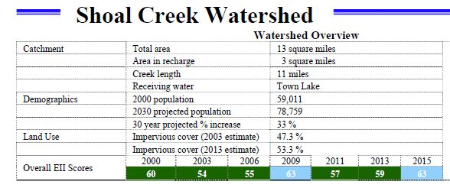
Adaptive Management Process
Monitor Improvements through the City Environmental Integrity Index (EII), modify measures as needed

Slide 14
Draft Watershed Protection Plan
Introduction – Watershed Characterization Summary
Water Quality Modeling
Estimated Load Reductions to Meet Goals
Management Measures and Load Reductions
Education and Outreach
Technical and Financial Assistance Needed
Management Measure Strategy and Milestones
Monitoring to Evaluate Implementation Effectiveness

Slide 15
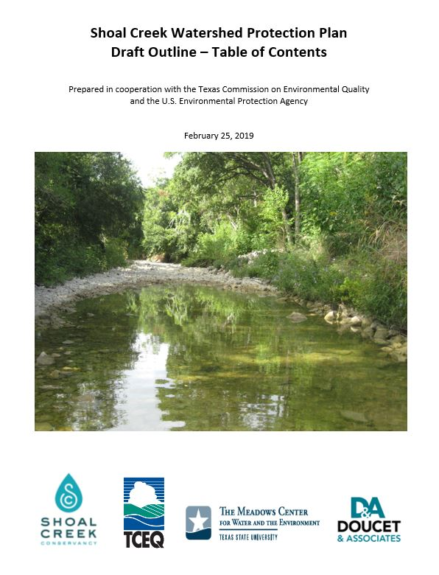
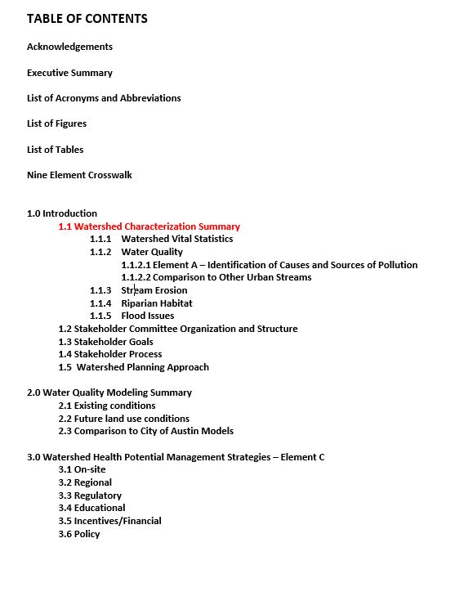
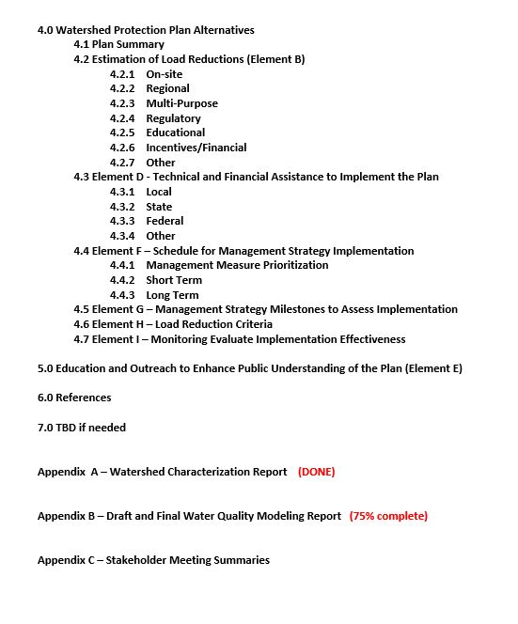
WPP Table of Contents

Slide 16
Next Steps
Prepare Draft Watershed Protection Plan – October 31
Final Modeling Report – October 31
Stakeholder Meetings/Work Groups
  Mid November
Final WPP to TCEQ - February 2020
WPP to EPA – Spring 2020

Slide 17
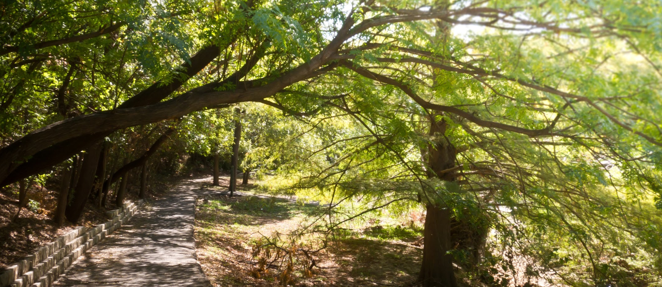
Thank you
Joanna Wolaver, Shoal Creek Conservancy joanna@shoalcreekconservancy.org www.shoalcreekconservancy.org/watershedplan
Wrap-Up & Public Comments

Slide 18



Partners
And Shoal Creek Stakeholders
This cooperative project is funded in part by the Texas Commission on Environmental Quality (TCEQ) through a United States Environmental Protection Agency (EPA) grant.

