Slide 1
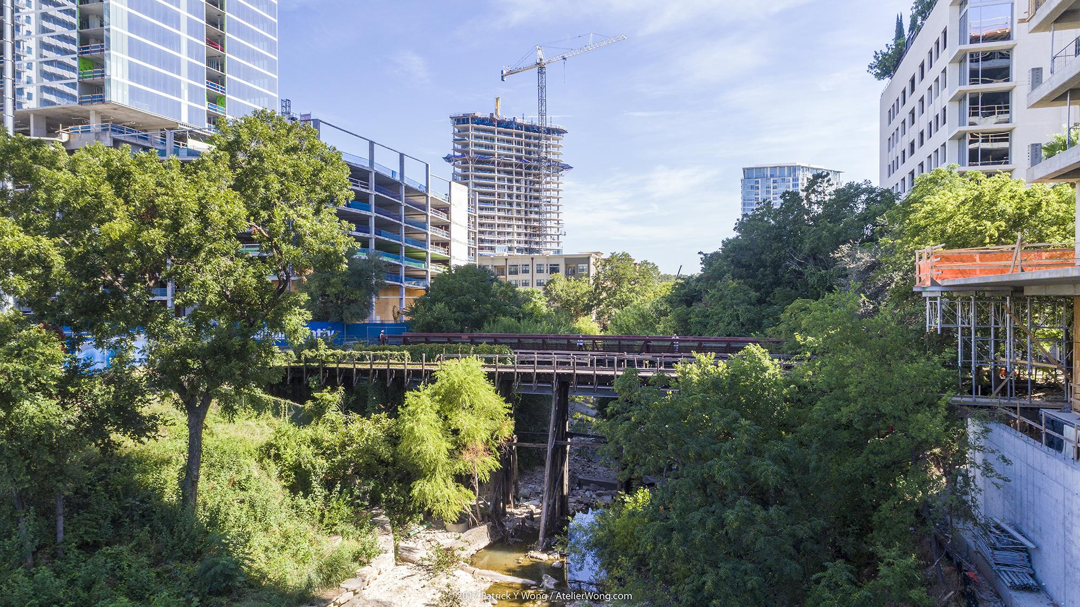
SHOAL CREEK WATERSHED ACTION PLAN
Steering Committee Meeting: 1.22.20
Notes:
Intro slide only

Slide 2
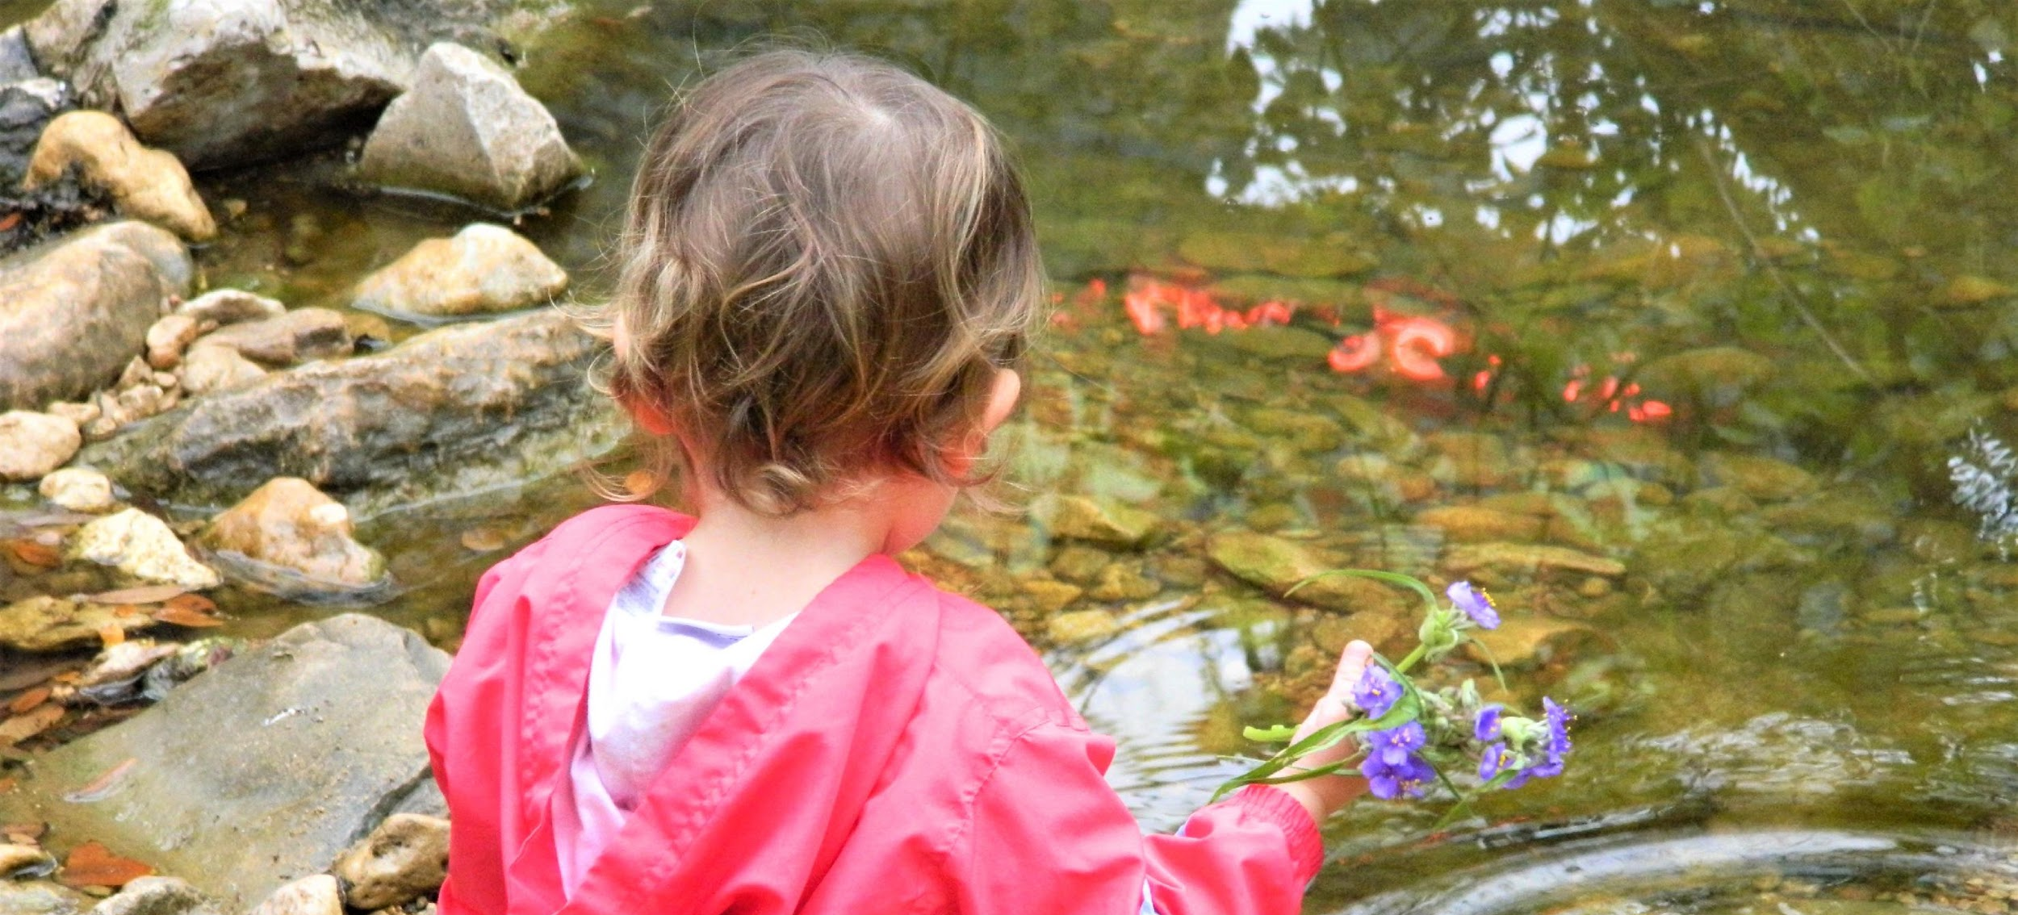
Welcome & Agenda Review
Quick Updates:
By Laws revised and added to project website: shoalcreekconservancy.org/watershedplan
Comments received on Watershed Characterization Report, next draft Jan. 30
Next meeting on Jan. 30 from 9:30 to 11 a.m (location downtown TBD)
Today:
Facilitated goal discussion
Organizational Meeting of Working Groups

Slide 3
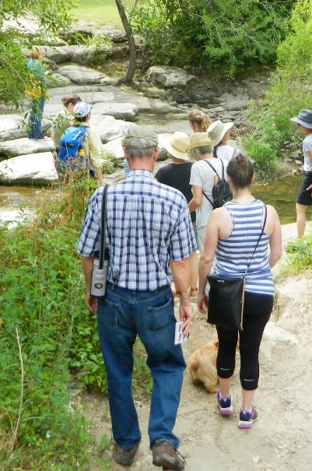
Project Background
2017 - The Shoal Creek Watershed Action Plan planning process began in late 2017 with SCC, MCWE, Doucet and the support, in part, from a 319 Clean Water Act grant from TCEQ through the United States Environmental Protection Agency.
Feb. 2018 - First Stakeholder meeting
Past 2 years - Over 150 stakeholders at 13 meetings provided ideas & feedback to form the basis for the first draft of the Shoal Creek Watershed Action Plan.
Now: We have a complete 1st draft of the Plan, updated with stakeholder feedback. Will be submitted to TCEQ by 2/28.

Slide 4
Stakeholder-created Goal:
Shoal Creek is a model healthy and resilient urban watershed that benefits people and nature and is supported by a well-informed and engaged community.

Slide 5
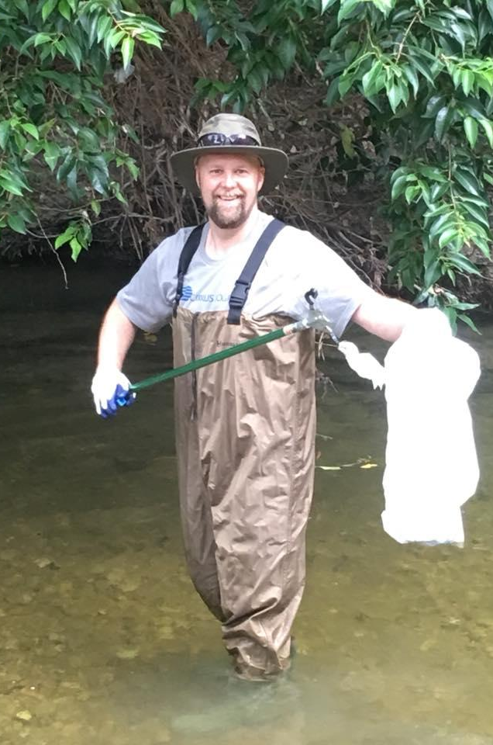
How to reach our goal:
Achieve contact recreation standards per TCEQ
Promote baseflow enhancement
Promote aquatic health
Enhance riparian health
Support City flood mitigation efforts
Consistently achieve “Good” water quality within 20 years per EII

Slide 6
Management Measures
For each of the 6 goals stated above, there’s at least 1 corresponding management measure in the plan:
informed by stakeholders & research
defined by scientific modeling
prioritized by effectiveness

Slide 7
Project Timeline
December/early January 2020 - stakeholder feedback from 1 draft of plan incorporated into plan
January 22 - Steering Committee meeting to review draft plan updates and roles of Steering Committee
February 15, 2020 - Deadline for final feedback from stakeholders
February 28, 2020 - Plan submitted to TCEQ
April 2020 - Formal approval of plan by Steering Committee
June 2020 - WPP to EPA

Slide 8
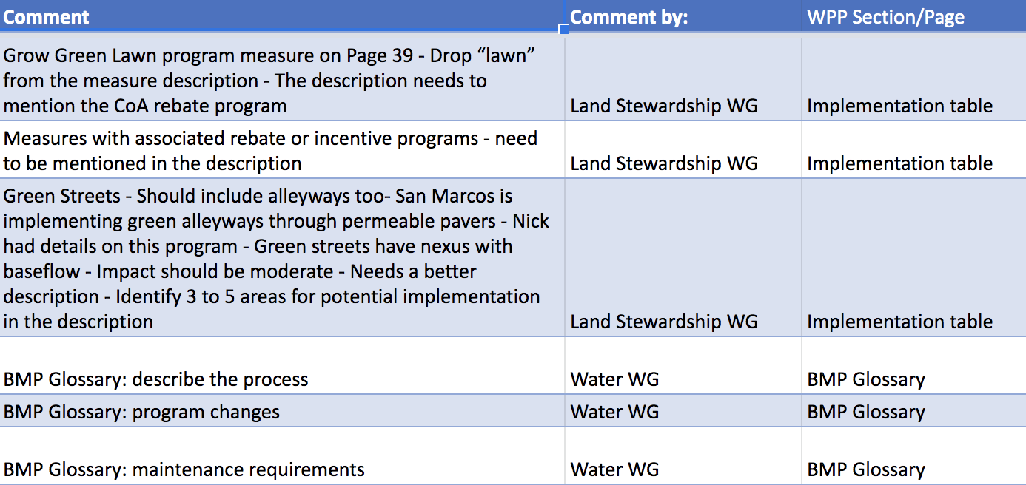
Stakeholder Feedback Snapshot
link to full chart

Slide 9
Section 7: Implementation Plan
Reference printed copies

Slide 10
Table 7
Reference printed copies

Slide 11
Stakeholder Committee: Role & Structure
Purpose:
Provide insight about public concerns and values, institutional knowledge
Help bridge scientific research & community efforts
Help develop the Plan & identify issues, goal, solutions
Structure:
Inclusive, open and welcoming to all
Meets every 3 to 4 months, through early 2020
Steering Committee - subset voting body
Working Groups - technical expertise and subject matter insight
Notes:
NICK - Please edit as you see fit!
- Stakeholder involvement and diverse representative key to success - essential component of WAP
Why?
Enhances cooperation, collaboration, and community participation.
Provides insight about public concerns and values that help bridge scientific research and community-driven efforts.
A Shoal Creek Watershed Stakeholder is anyone who lives, works and shares an interest in protecting and restoring the Shoal Creek watershed.
The intent of this planning process is to be inclusive, open and welcoming to all.
- There will be no limit on the number of participants.
- The Committee will be a non-voting entity.

Slide 12
Steering Committee: Role & Structure
Voting body of the Stakeholder Committee
Includes representatives of 8 to 10 key decision-making entities but no specified limit to Steering Committee membership
Provides guidance and leadership to WAP development and implementation
Governed by Ground Rules
All decisions shared with full Stakeholder Committee

Slide 13
Steering Committee By Laws
See printed copies of Public Participation Plan

Slide 14
Next Steps
Schedule future Steering Committee meetings
Quarterly meetings
Locations and times of days should vary
What days of the week, times of day and locations should we rotate between?

Slide 15
Thank you Joanna Wolaver, Shoal Creek Conservancy joanna@shoalcreekconservancy.org www.shoalcreekconservancy.org/watershedplan
Wrap-Up & Public Comments

Slide 16
Partners
And Shoal Creek Stakeholders
This cooperative project is funded in part by the Texas Commission on Environmental Quality (TCEQ) through a United States Environmental Protection Agency (EPA) grant.

